Slide 1
IPL ANALYSIS
AKASH MEGHANI

Slide 2
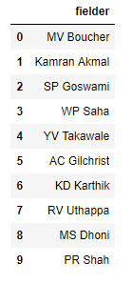
WICKET KEEPING ANALYSIS
First, We had to find out the list of wicket keepers because stumping can only be done by the wicket keeper.
Here is the list of wickets keepers.

Slide 3
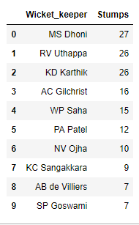
WICKET KEEPING ANALYSIS
Number of stumps done by the wicketkeeper.

Slide 4
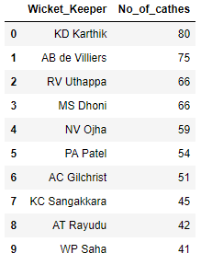
WICKET KEEPING ANALYSIS
Number of catches taken by the wicketkeeper:-

Slide 5
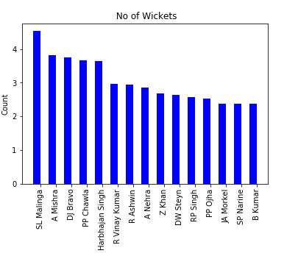
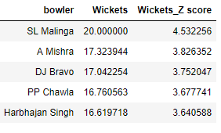
Normalization of BOwling
Z-score calculation:-

